Slide 1
Shawn Healy Resident Scholar and Director of Professional Development
Mary Ellen Daneels
Social Studies Teacher
West Chicago Community H.S.
McCormick Foundation Civics Program News Literacy Overview

Slide 2
Core Indicators of Civic Engagement
A. Civic indicators
1. Community problem solving
2. Regular volunteering for nonelectoral organization
3. Active membership in a group or association
4. Participation in a fundraising run/ walk/ ride
5. Other fundraising for charity
B. Political indicators
1. Regular voting
2. Persuading others
3. Displaying buttons, signs, stickers
4. Campaign contributions
5. Volunteering for candidate or political orgs
C. Indicators of public voice
1. Contacting officials
2. Contacting the print media
3. Contacting the broadcast media
4. Protesting
5. Email petitions
6. Written petitions
7. Boycotting
8. Buycotting
9. Canvassing
D. Indicators of cognitive engagement
1. Following govt and public affairs
2. Talking with family and friends about politics
3. Political knowledge
4. Attention to the news media
Notes:
Where do your young patrons/ students get their news?

Slide 3
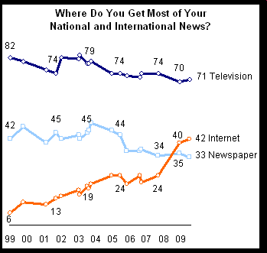
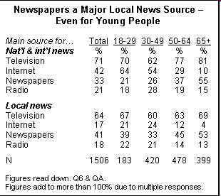
Millennials Tuned Out
“Press Accuracy Rating Hits Two Decade Low”
-Report published by the Pew Center for the People and the Press (Sept 13, 2009)
Notes:
3
Where do your young patrons/ students get their news?

Slide 4
Millennials Tuned Out (continued)
“Young People and the News”
-Report prepared by Thomas Paterson of the Shorenstein Center on the Press (July 2007)
- Newspapers? Only 9% of teenagers read a newspaper daily, 46% hardly ever/not at all
-National television news? 31% of teenagers watch national TV news daily, 22% several times a week, and 23% once a week. Similar numbers for local news.
-Radio? 25% listen to radio news daily, 13% several times a week, and 18% once a week.
-The Internet? 20% use the internet as a news source daily, 23% several times a week, and 15% once weekly. A full 32% do not use the internet as a news source.
-Young people watch non-news related programming and read magazines and books in similar numbers with older adults (Source: Pew Research Center Biennial News Consumption Survey, 2004)
Notes:
Where do your young patrons/ students get their news?

Slide 5
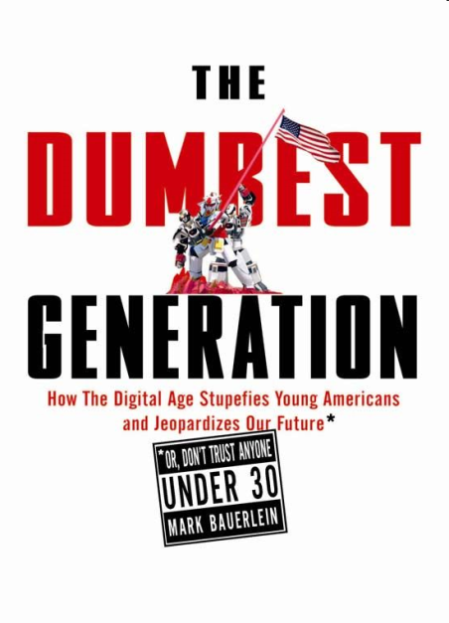
The Dumbest Generation?
Written by Mark Bauerlein (2008), selected excerpts:
-Opportunity: “All the ingredients for making and
informed and intelligent citizen are in place. But it hasn’t
happened.”
-Outcome: “Most young Americans possess little of the
knowledge that makes for an informed citizen, and too
few of them master the skills needed to negotiate an information-heavy, communication-based society and economy.”
-Paradox of the Dumbest Generation
-The Problem: “Uninterested in reading and unworried about the consequences, kids reject books as they do vegetables, and the exhortations of their teachers fall flat. A quick glance at their newspaper once a day would augment their courses in government…But those complements don’t happen.”
-The Consequences: “Democracy requires an informed electorate, and knowledge deficits equal civic decay. Individual freedom means the freedom not to vote, not to read the newspaper, not to contemplate the facts of U.S. history, not to frequent the public square—in a word, to opt out of civic life.”
Notes:
Where do your young patrons/ students get their news?

Slide 6
Is Voting for Young People?
Central argument: “…Over the last three decades, politics and voting have indeed become more and more the province of the elderly, which will be shown to be the case not only in the United States, but throughout the world’s advanced industrialized democracies. There is in fact a rift between politicians and young adults, although not one of mutual contempt but rather of mutual neglect.”
1. “The younger someone is, the less likely he or she is reading a newspaper.”
2. TV news audience heavily skewed toward the elderly; young people switch to other programs when political events are televised
3. “Young adults today can hardly challenge the political establishment if they don’t have a basic grasp of what is going on in the political world.
4. Lowered voting age contributed to decline in turnout rates among young people—global phenomenon
Notes:
6

Slide 7
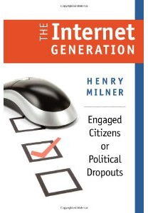
The Internet Generation: Engaged Citizens or Political Dropouts?
Political dropouts: “…young citizens so inattentive to the political world around them that they lack the minimal knowledge needed to distinguish and thus choose among parties or candidates.”
1. Previous generations voted on the basis of civic duty; nowadays, political knowledge is the driving force
2. “…The digital divide is increasingly based on skills.”
3. Solutions:
a. “…Schools systems of the countries high in civic literacy were better at encouraging a larger proportion of students to read newspapers and books, use libraries and maps, write letters, etc, habits they retained into adulthood.”
b. “A key dimension lies in integrating the course content with the communications networks that link members of the Internet generation, so as to break down the barriers between the political world and the world of the young adult.”
Notes:
7

Slide 8
Tim McNulty
Journalism Professor
Northwestern University
McCormick Foundation Civics Program What Makes Students News Literate?
Notes:
8

Slide 9
Jamie Loo
Online Resources Producer
McCormick Foundation Civics Program
McCormick Foundation Civics Program News Literacy Lesson Plan
and Online Resources
Notes:
9

Slide 10
Why is news literacy important?
News literacy prepares students to become well informed so they can
become active and involved citizens. Effective news literacy programs
help students develop skills in a variety of areas such as:
-Public speaking and listening
-Persuasive writing
-Critical thinking and reasoning through evaluating different
sources of information
-Learning current events, defining civic problems of importance and thinking critically about solutions
A 2008 study by the Newspaper Association of America found that students
who directly participate in high school journalism and yearbook classes
have higher overall grade point averages and ACT test scores compared
to their peers.
Notes:
10

Slide 11
Intro. to News Literacy exercise
We’ve developed a short lesson plan that introduces the concepts
of news literacy, ideas to broaden the use of news in the
classroom, and additional resources.
In it students will learn to identify
the basic components of a story and analyze its content. This
exercise asks students to:
-Summarize the content of the article
-Relate it to course content
-List three facts presented by the article
-Identify and evaluate the sources in the article
-Identify information that is needed or unclear
Notes:
11

Slide 12
Intro. to News Literacy exercise
Break into pairs and complete the worksheet. Refer to the Student
Worksheet Supplement in the lesson plan if you need help with
definitions.
When you and your partner are done with the worksheet look at the
Extensions sheet and brainstorm the following questions:
What extensions can I use in the classroom with this article or
particular topic? Explain how you would use it.
What other extensions are not listed that you think would work
well with this article or topic?
Notes:
12

Slide 13
What did you find?
Notes:
13

Slide 14
Additional resources
The last page of the lesson plan includes
additional resources for teaching news in the
classroom and news literacy.
Here are a few highlights.
Notes:
14

Slide 15
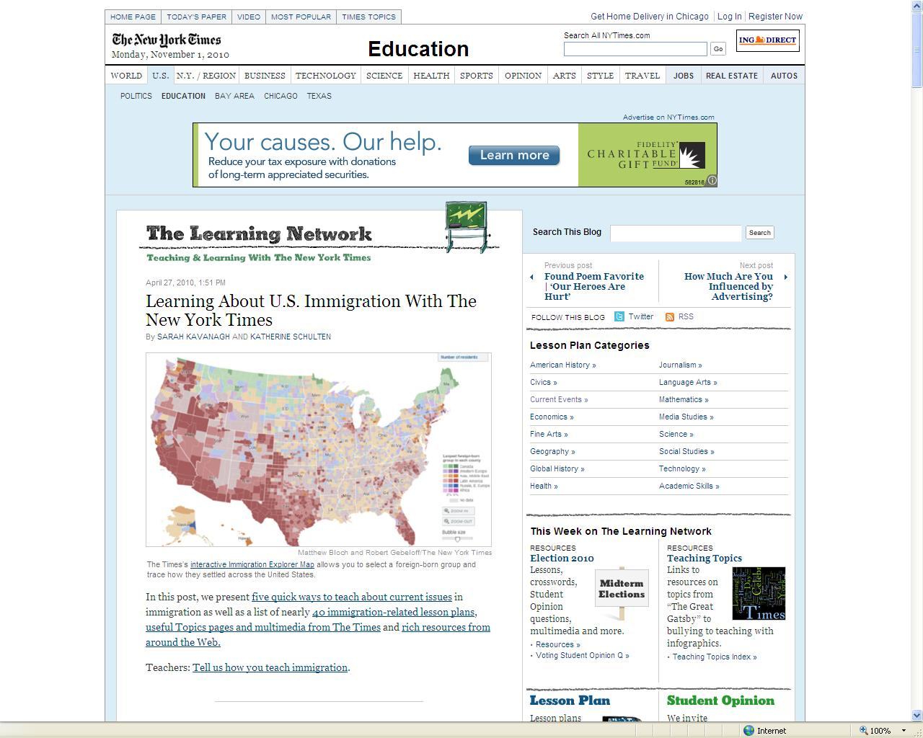
Notes:
15

Slide 16
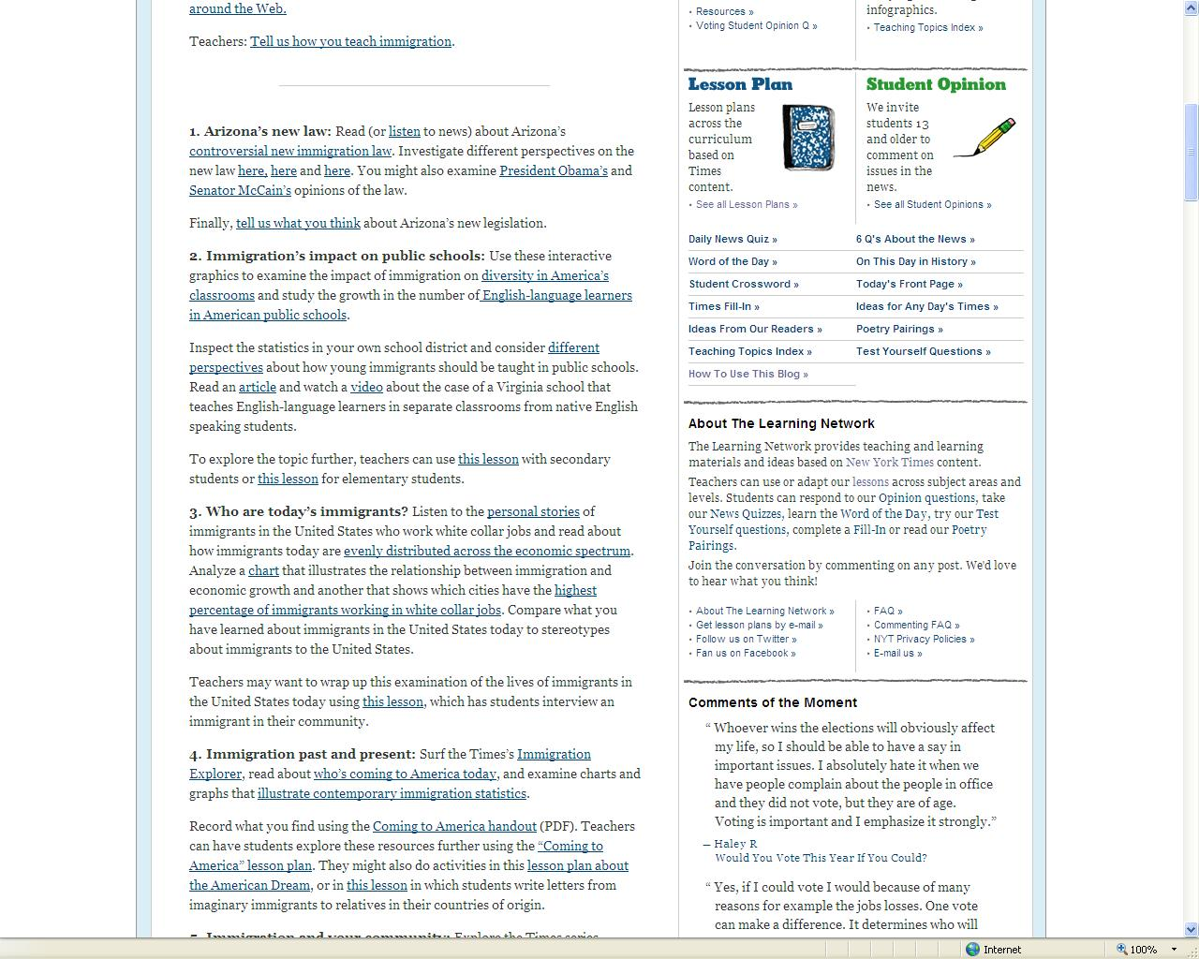
Notes:
16

Slide 17
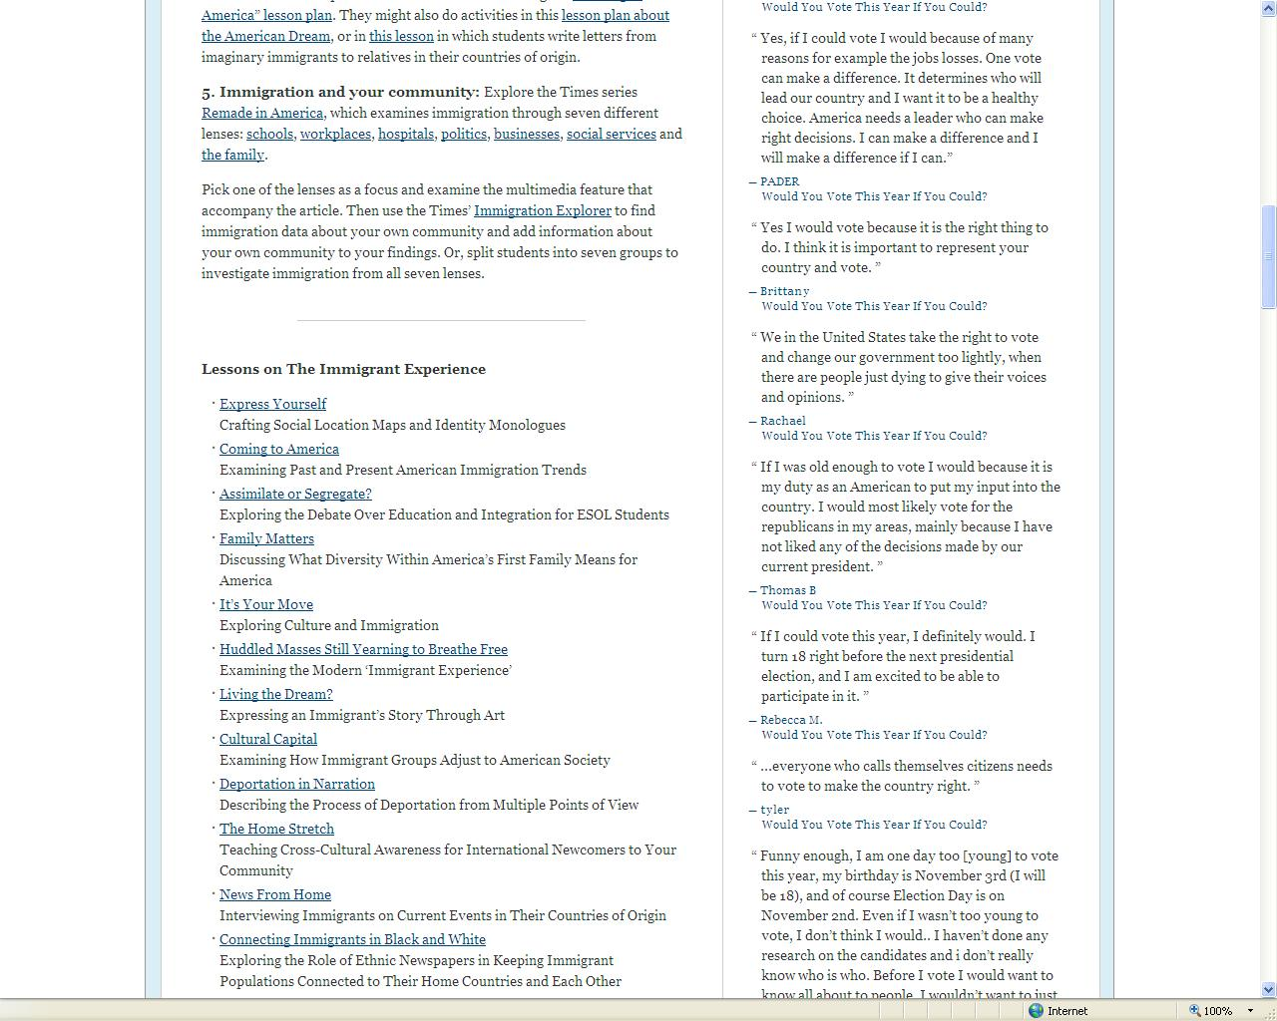

Slide 18
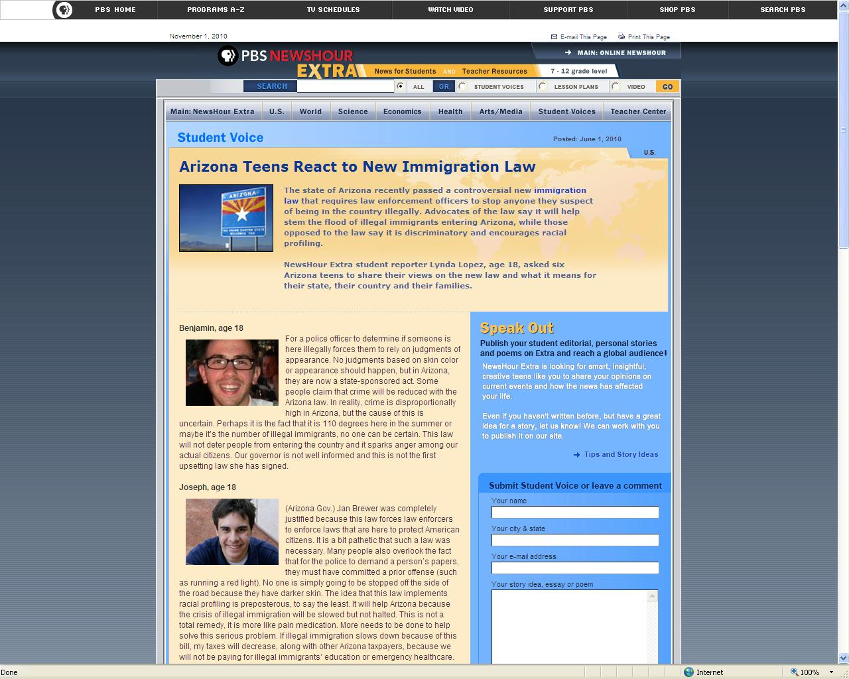

Slide 20
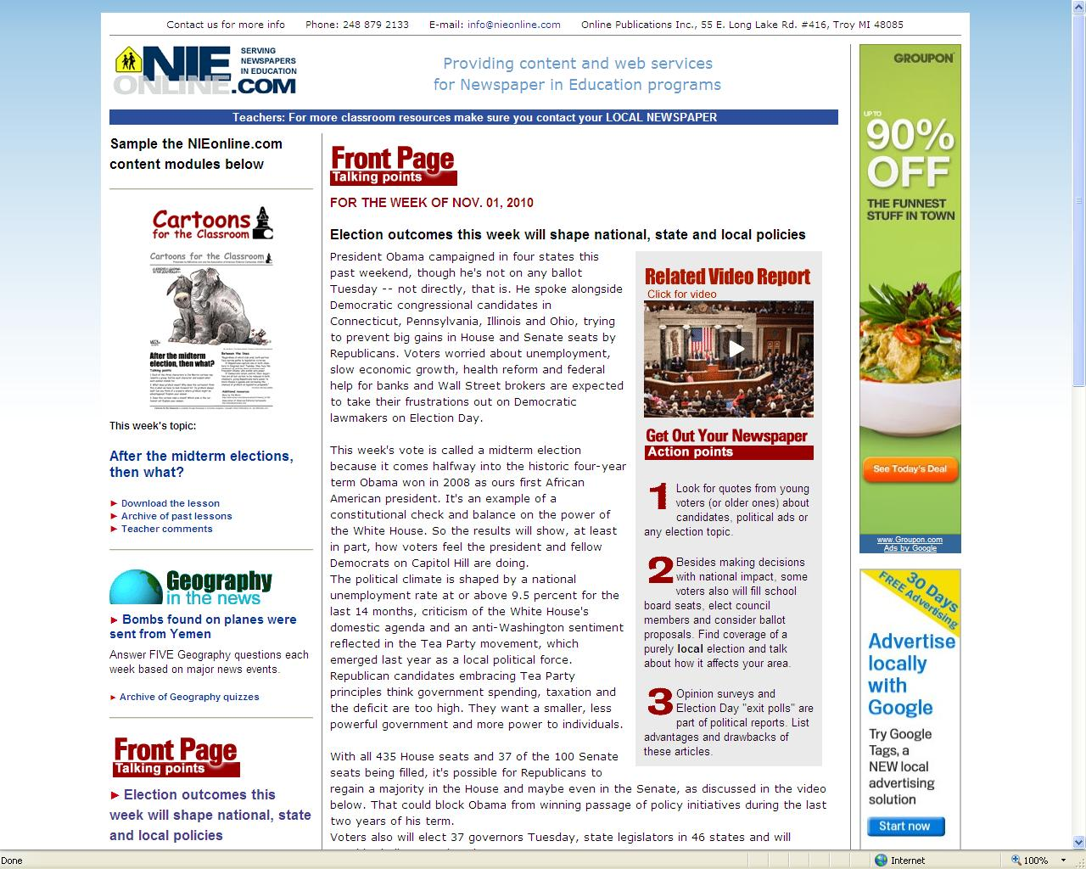

Slide 23
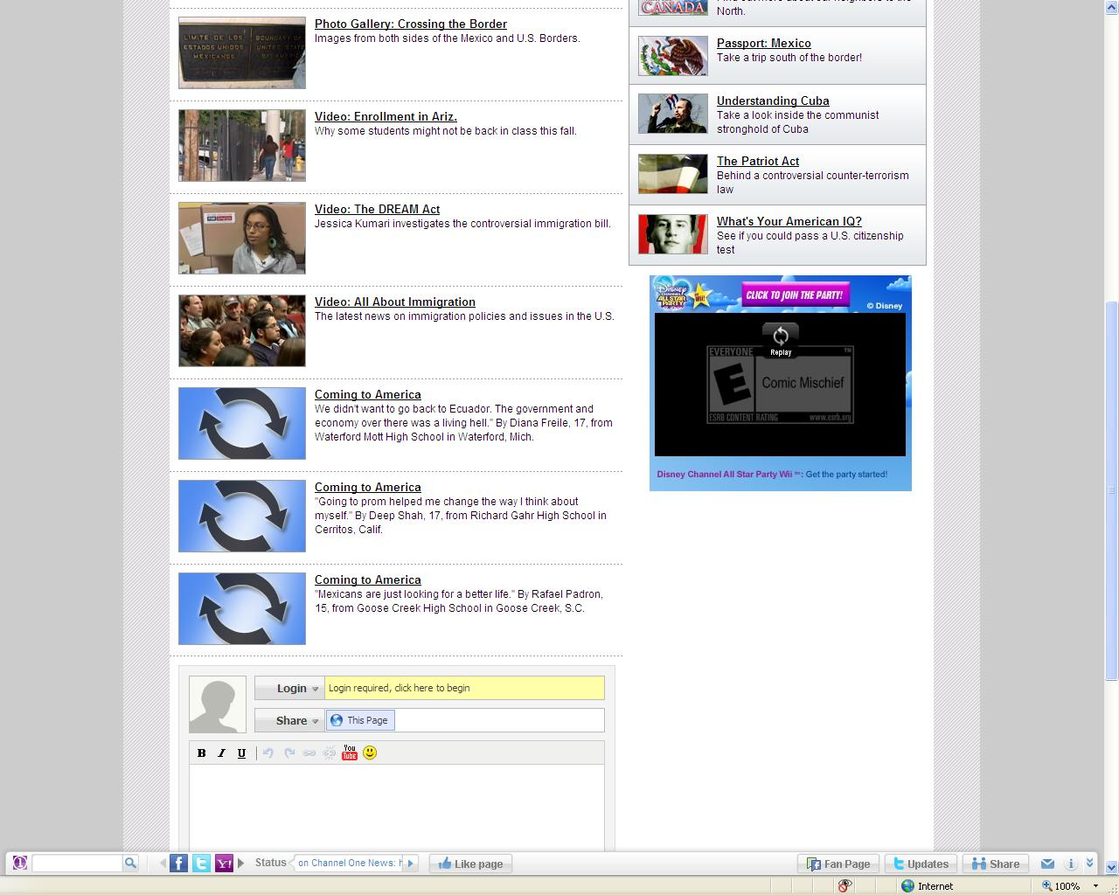

Slide 24
Peter Adams
Chicago Program Manager
News Literacy Project
McCormick Foundation Civics Program News Literacy Project
Notes:
24

Slide 25
What Is News Literacy?
News literacy defined: “The ability to determine the credibility of news reports and other information, whether delivered through print, television, radio or the Internet.” (News Literacy Project)
Goals of News Literacy:
1. To “teach students the critical thinking skills they need to be smarter and more frequent consumers and creators of credible information across all media and platforms” (NLP)
2. To enable students to distinguish between verified information and raw messages, opinion, spin, and gossip.
3. To encourage students to seek information that will make them well-informed citizens and voters.
4. To expose students to positive role models in the field of journalism and the process by which news is reported, edited, and produced.
Notes:
25

Slide 26
What Is News Literacy?
Why does news matter?
1. What issues have an impact on students?
2. What are the core elements of quality journalism?
3. Why should students view quality journalism as a benchmark against which to measure other sources of information? 4. Why have so many people turned away from mainstream media?
5. Who are the “gatekeepers?”
6. Does ownership of media companies affect what is reported and how it is reported?
Notes:
26

Slide 27
What Is News Literacy? (Continued)
How can students know what to believe?
1. How does one define news, opinion, advertising, publicity, entertainment, propaganda, and raw information?
2. What is the difference between assertion and verification?
3. What is a source?
4. What is bias?
5. What is documentation?
6. What is fairness?
7. Why does context matter?
8. Why do mistakes appear in news
accounts? How do journalists learn from
them?
9. What standards or limitations exist for putting information on the Internet?
10. How does one determine who created a
piece of information? Why is it important?

Slide 28
What Is News Literacy? (Continued)
What challenges do the Internet and the Digital Age create?
1. What standards exist for putting information on the Internet?
2. What are the strengths and weaknesses of…
A. Wikipedia
B. Google?
C. YouTube?
3. Why is it important to determine who created a piece of information?
4. How does one go about doing this?
5. Why have social networking sites grown as sources of information for young people?
6. How will learning the navigation of the Internet deter deception?
7. How can emailing, texting, and blogging impact oneself and others?

Slide 29
Sources
Bauerlein, Mark. 2008. The Dumbest Generation: How the Digital Age Stupifies Young Americans and Jeopardizes Our Future. NY: Penguin.
Center for News Literacy. Available online: http://www.stonybrook.edu/journalism/newsliteracy/index.html.
Cunningham, Brent, and Miller, Alan C. 2010. “As Journalism Changes, So Must You.” USA Today. Arlington VA: April 13.
Garber, Megan. 2009. “Leap of Faith: Inside the Movement to Build an Audience of
Citizens.” Columbia Journalism Review. NY: July/ August.
Milner, Henry. 2010. The Internet Generation: Engaged Citizens or Political Dropouts. Medford, MA: Tufts U. Press.
Mindich, David T.Z. 2004. Tuned Out: Why Americans Under 40 Don’t Follow the
News. NY: Oxford University Press.
News Literacy Project. Available online: http://www.thenewsliteracyproject.org/. Accessed: November 9, 2010.
Paterson, Thomas. 2007. Young People and the News. Boston: Joan Shorenstein Center
On the Press, Politics, and Public Policy, John F. Kennedy School of Government, Harvard University. Available online: http://www.hks.harvard.edu/presspol/research/carnegie-knight/young_people_and_news_2007.pdf. (July)
“Press Accuracy Hits Two-Decade Low.” 2009. Pew Research Center for the People and the Press. Available online: http://people-press.org/report/543/. September 13.
Wattenberg, Martin P. 2008. Is Voting for Young People? NY: Pearson.
Zukin, Cliff, et al. 2006. A New Engagement?: Political Participation, Civic Life, and the Changing American Citizen. NY: Oxford U. Press.

